Slide 1

Enlightened: What we’ve learned from planets and light

Slide 2
An Ancient Quest
Since earliest human history, science has advanced primarily through our quest to understand two things:
The motion of the sun, stars, planets, and other heavenly bodies.
The nature of light.
The first is arguably how “science” began (leading to the creation of what we now call “physics”), while the second has led us to profound and surprising discoveries about the nature of reality itself.
Big things happen when the two are combined

Slide 3
A Brief History of Gravity…
Contrary to some claims, most ancient cultures understood that the Earth was spherical:
The Greeks knew this by 500 BC at the latest
In his treatise “One the Heavens” (~350 BC), Aristotle put forth a longwinded (and totally nonsense) philosophical argument that all things must fall toward the center of the Earth
You could argue that this was kinda sorta gravity, but it also meant Earth had to be the center of the solar system (put a pin in that!)
Interestingly, about a century later, Aristarchus of Samos proposed a heliocentric system, but it never caught on and was largely forgotten.*
*See “The Sand Reckoner” by Archimedes

Slide 4
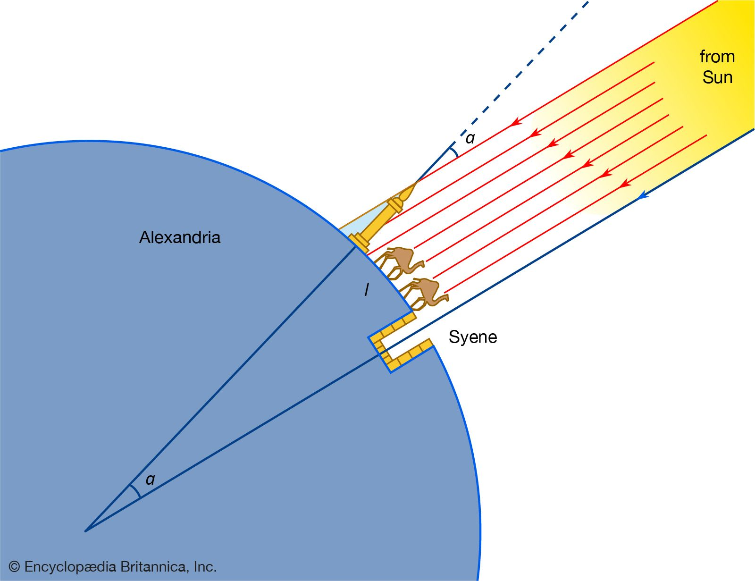
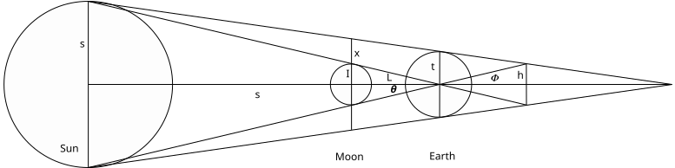
The Size of the Earth and Moon
In 240 BC, Eratosthenes estimated the size of the Earth by comparing shadows in two different locations
Correct to about 10%
Around 150 BC, Hipparchus used the fact that a total solar eclipse in Hellespont was only 4/5 of an eclipse in Alexandria to estimate the distance to the Moon
Correct to about 20%

Slide 5
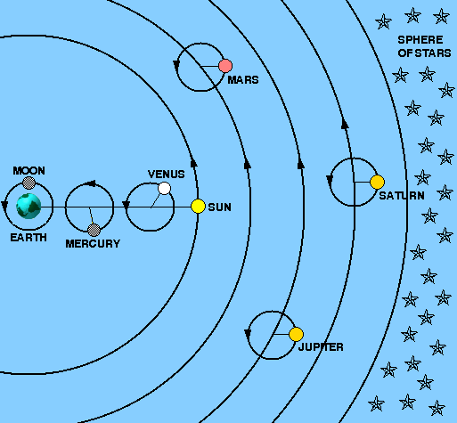
Ptolemy’s Solar System
Like most of the ancients, Ptolemy believe the sun, Moon, and planets all orbited the Earth
The problem was “retrograde” motion, in which planets appeared to reverse course.
In his masterwork, “Almagest” (150 AD), Ptolemy solved this problem by adding “epicycles” (circles on circles)
This model was very accurate.
Correctly predicted observed planetary motion as well as solar and lunar eclipses.
Became the accepted model for the next 1500 years!

Slide 6
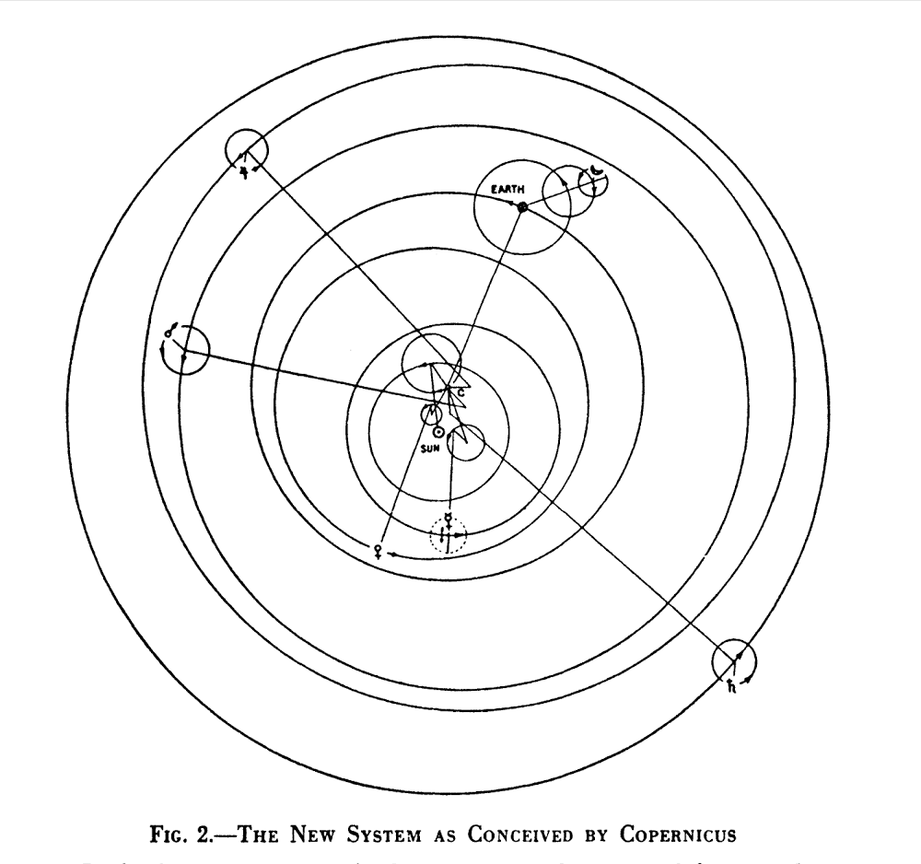
Return of Heliocentrism
In 1543, Nicolaus Copernicus* published “On the Revolutions of the Celestial Spheres”, in which he proposed that the Earth and the other planets orbit the sun.
This was famously championed by Galileo in “Dialogue Concerning the Two Chief World Systems” in 1632**, but there was a problem
Precise observational data (particularly by Tycho Brahe) were not consistent with circular orbits.
In order to fit the data, Copernicus added – you guessed it – epicycles!
Although closer to what we now accept as reality, the model was really no better than Ptolemy’s
*unaware of Aristarchus!
** See “Galileo’s Daughter”, by Dava Sobel and “Galileo, Science, and the Church”, by Jerome Langford

Slide 7
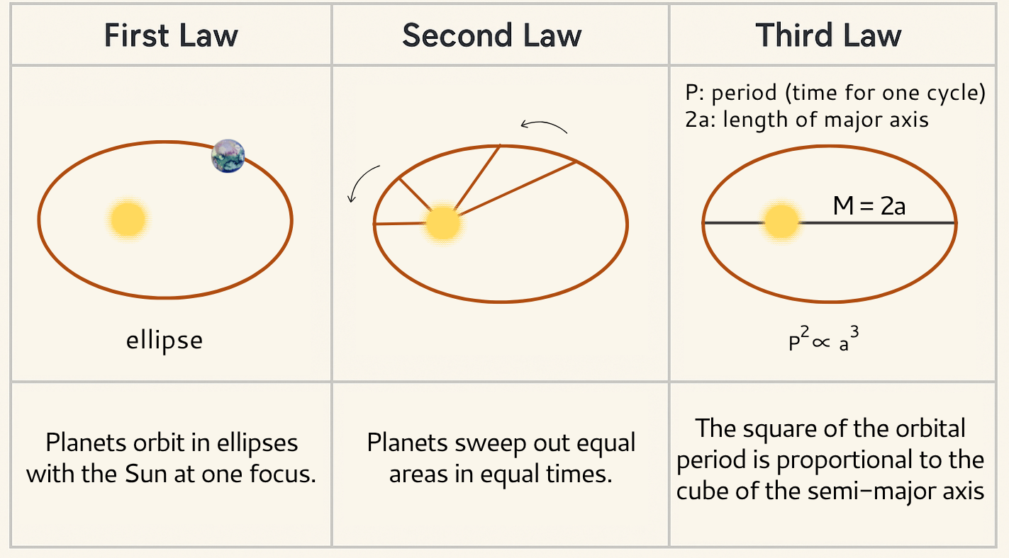
Enter Kepler
Between 1609 and 1619, Johannes Kepler showed that you could explain ALL the observational data exactly with three simple laws:
These were no more motivated than Ptolemy’s or Copernicus’ epicycles, but they were much simpler.
Kepler tried to convince Galileo of this, but Galileo rudely blew him off.

Slide 8
Newton Brings it Home…
In 1687, Isaac Newton published the “The Mathematical Principles of Natural Philosophy” in which he proposed the “universal law of gravitation”, in which put forth his laws of motion, including.
He then came up with the “universal law of gravitation”, in which two massive bodies exert an attractive force proportional to the product of their masses divided by the square of the distance between them.
This didn’t have to explain all the planetary observations, it just had to predict Kepler’s Laws, which it did (of course he had to invent calculus along the way.
This was the true beginning of physics. Now on to light…
Force
Acceleration
mass

Slide 9
A (very!) Brief History of Light
5th century BC: the Greek philosopher Empedocles postulated that light traveled in “rays” from the eyes, allowing us to see
Why can’t we see in the dark?
3rd century BC: Euclid worked out ray-based theories of reflection, still assuming light rays came from the eye
although he did toy with the idea they might go in the other direction.
2nd century AD: Ptolomy extended Euclid’s work to include refraction (bending of light).
~1000 AD: The Arab scientist Alhazen created the first fairly accurate model of vision (including the direction of light rays)
~1600 AD: German scientist Johannes Kepler invents modern optics and image formation, explaining how lenses, mirrors, telescopes, microscopes, etc. work.
He also tried to tell Galileo about this and got a nasty letter in response.

Slide 10
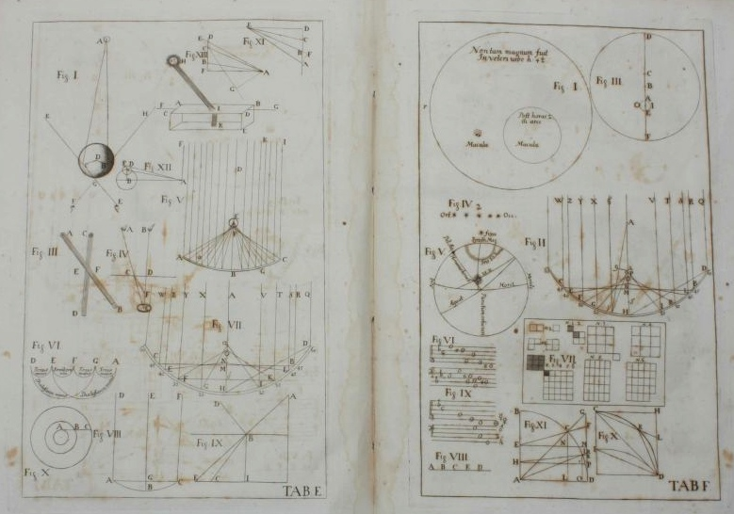
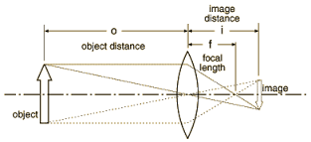
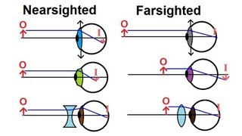
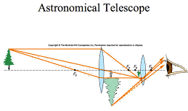
Keplerian Image Formation

Slide 11
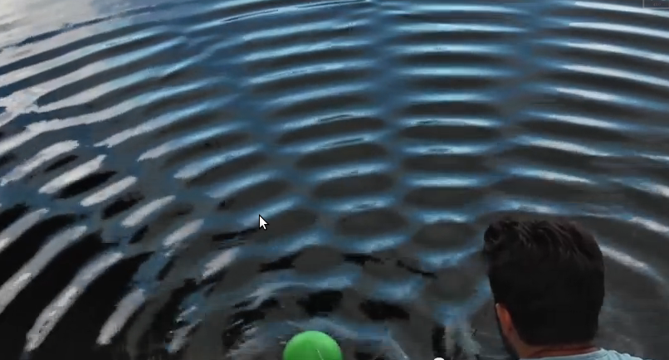
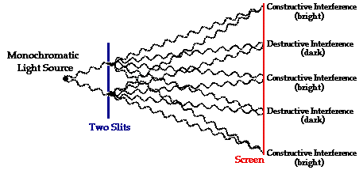
Nature of Light: Waves or Particles?
People were divided over whether light “rays” consisted of particles (“corpuscular theory”) or waves.
If waves, then they should “interfere” (add or cancel out)
Example: Interference of waves on water

Slide 12
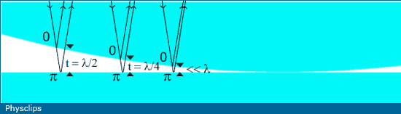
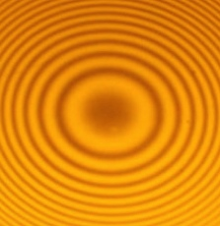
Newton’s Rings
Isaac Newton (who firmly believed light was a particle!) observed interference by placing a curved surface against a flat surface
These “Newton’s Rings” were strong evidence that light is a wave!
Can also calculate the wavelength.
Top View

Slide 13
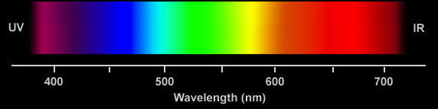
Color and Wavelength
Newton also observed that a prism split light into different colors
Hypothesized that different colors were different “corpuscles”
In 1802, using interference techniques, Thomas Young determined that each color had unique wavelength
The picture is starting to come together: reflection, refraction, image formation, color. What’s left?
1 nanometer = 1 billionth of a meter

Slide 14

How fast does light move?
Since the 5th century BC, philosophers wondered how fast light moved.
In the 17th century, at least two attempts were made to measure the speed of light.
In 1629, Isaac Beeckman carried out an experiment in which looked for the time it took a cannon flash to reflect from a mirror a mile away.
Around 1638, Galileo (possibly) tried to measure the speed of light using two men with lanterns on distant hilltops
Both men concluded that light was too fast to be measured in these simple ways.

Slide 15
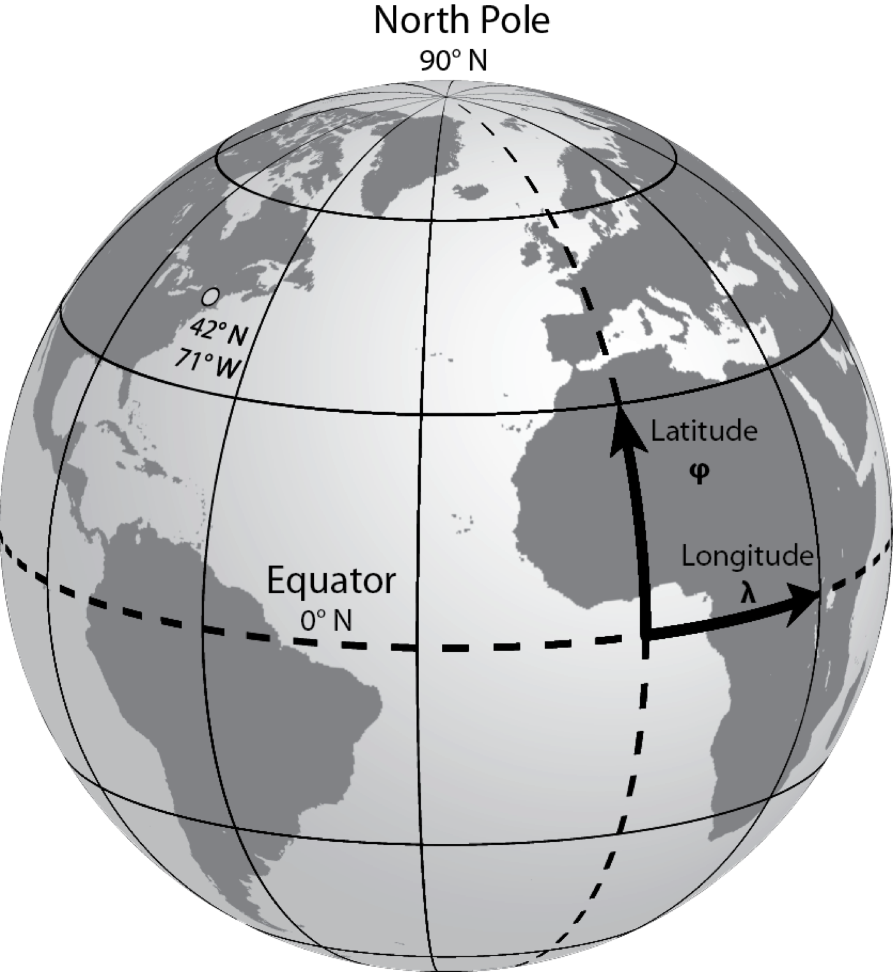
Digression: Latitude and Longitude
Our method of specifying a location on the Earth dates back at least to Eratosthenes, in the 3rd Century BC.
First person to measure the circumference of the Earth
To measure latitude, all we need to do is measure the angle between the North Star and the horizon
Because the earth is turning, in order to measure longitude, we need to know an angle to a star and the absolute time.
1 minute = 16 miles at the Equator!
This was THE BIG PROBLEM in navigation for several hundred years.
Caused many ships to get lost or run aground.
Many governments offered big rewards to solve the problem.
What the heck does this have to do with light?
Bear with me!

Slide 16
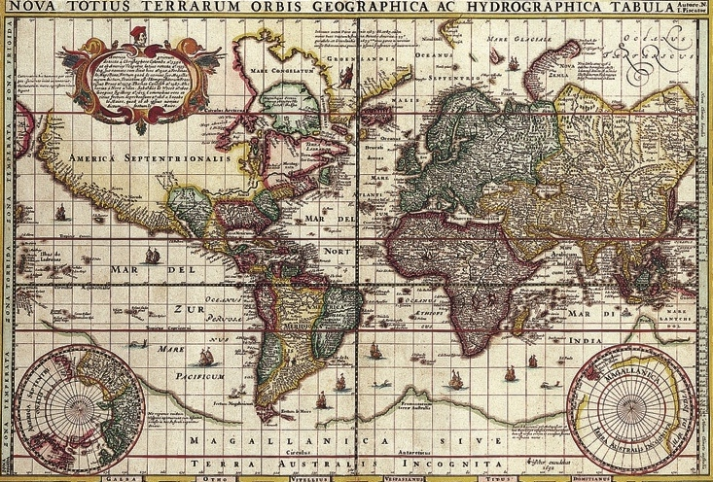
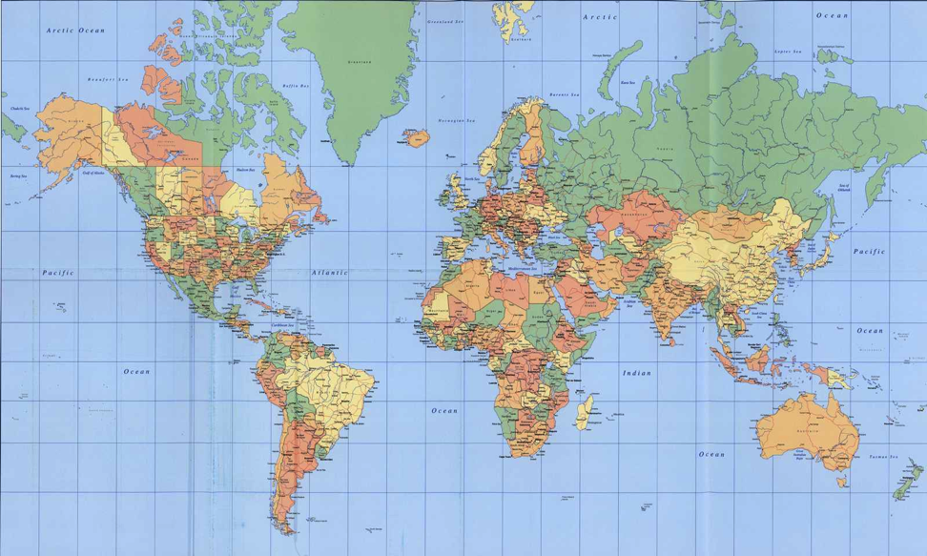
Maps and the New World
By the 16th and 17th centuries, Old World maps were pretty accurate
Elsewhere, latitude could be very precise, but longitude could be wildly off
Now it mattered!
Ships had to navigate over large distances with no landmarks
Whole fleets ran aground
Governments offered rewards to solve the “longitude problem”
What does this have to do with light?
Willem Janszoon Blaeu, ~1630
Modern

Slide 17
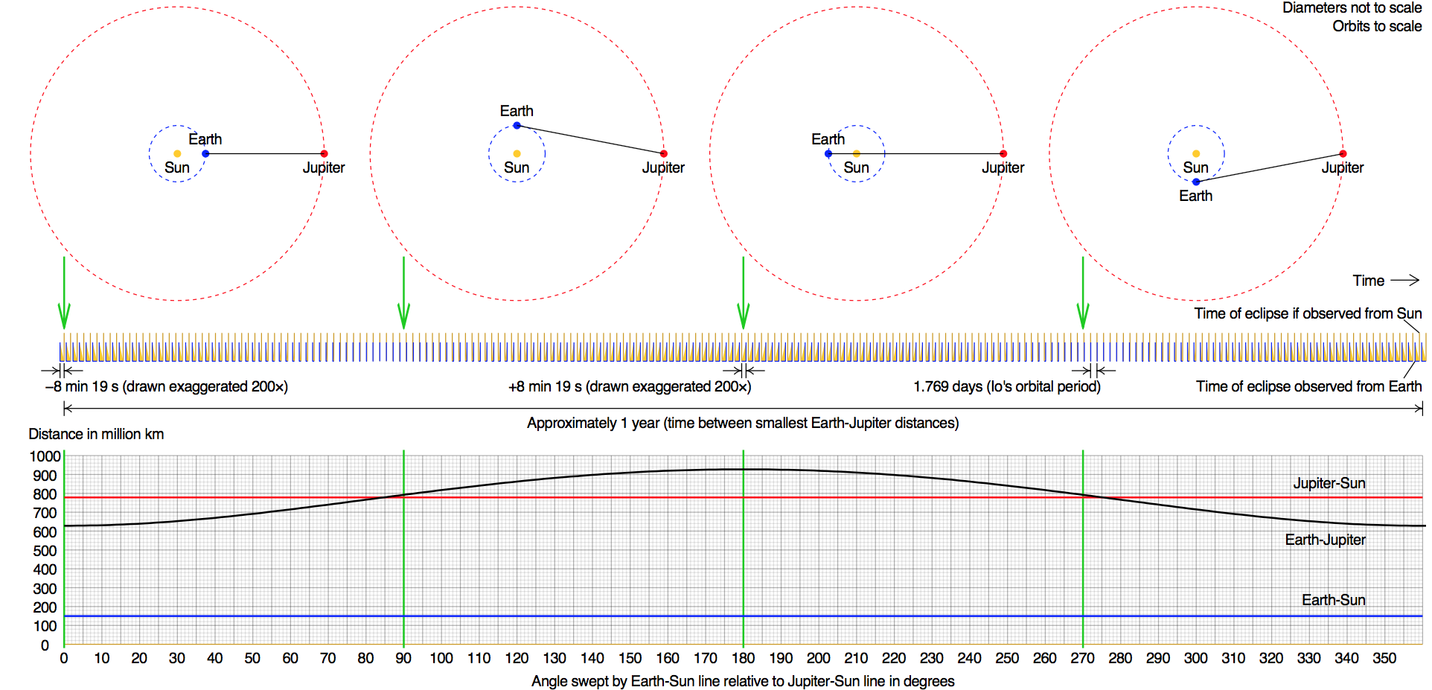
Rømer’s Accidental Discovery
People assumed that no clock could measure time so precisely, so it would have to be based on some sort of astronomical observation.
In 1676, the Danish astronomer Ole Rømer was trying to win the “Longitude Prize”, offered by King Phillip III of Spain, by observing the moons of Jupiter, as suggested by Galileo.
He found that the period was shorter or longer depending on whether the Earth was approaching or receding from Jupiter, leading to a difference of around 20 minutes as the Earth went from one side of the sun to the other
Remember, 1 minute = 16 mile error in position at the Equator!
He and Christian Huygens realized they could explain this if light had a finite speed, which they calculated to be about 135,000 miles per second
Correct answer: 186,000 miles per second
Spoiler: the longitude problem was eventually solved with a clock, invented by John Harrison (see “Longitude” by Dava Sobel!)

Slide 18
Moving on: Another Happy Accident
The 19th Century was the golden age of experimental physics, particularly experiments involving electricity and magnetism.
By the second half of the century, scientists had learned
Electric fields are created by electric charges
Magnetic fields are created by moving charges
Electric fields can also be created by changing magnetic fields
This is how generators work

Slide 19
Maxwell’s Equations
In 1861, James Clerk Maxell attempted to collect everything that was known about Electricity and Magnetism into a single set of equations.
He was almost able to express all of the existing experimental observations as a self-consistent set of mathematical equations
There was one (seemingly) small problem having to do with magnetic fields.
For purely mathematical reasons, he added an extra term
In addition to electric currents, magnetic fields could be generated by changing electric fields.
This turned out to have rather profound implications…

Slide 20
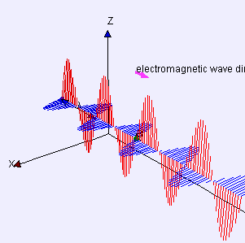
Electromagnetic Waves
Before, it was believed that you needed electric charges to make an electric or magnetic field, but Maxwell’s Equations showed you could have
(changing electric field)➔(changing magnetic field)➔ (changing electric field)➔
“Electromagnetic Wave”
What’s more, Maxwell could calculate the velocity at which such a wave would travel
It exactly matched the speed of light!!!
He wrote (with trembling hands, maybe?):
"we can scarcely avoid the inference that light consists in the transverse undulations of the same medium which is the cause of electric and magnetic phenomena"

Slide 21
It’s all the same thing…
In one fell swoop, Maxwell not only unified electricity and magnetism, but his results would eventually show that light, heat, radio waves, x-rays, gamma rays, etc., are all really the same thing – differing only in wavelength!
The entire visible spectrum.

Slide 22
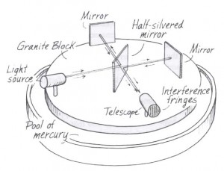
What’s “undulating”?
As often happens science, one answer raised a lot more questions.
All (other) known waves require a “medium” (air, water, earth, “the wave”) to travel through.
Light at least appears to travel through a vacuum.
In science, always try the simplest answer first:
Maybe vacuum isn’t really empty?
Scientists hypothesized the existence of “luminiferous aether”, and started to look for it…
The “Michelson-Morley Experiment” (1887) looked for difference in velocity based on whether a beam was traveling along the direction of the Earth’s motion or transvers to it: no effect found!
Biggest mystery in science for 20 years!

Slide 23
Einstein to the Rescue
In 1905, Albert Einstein postulated that perhaps the equations meant exactly what they appeared to mean:
The speed of light was the same in any frame in which is was measured.
He showed that this could “work”, but only if you gave up the notion of fixed time.
➔ “Special Theory of Relativity”
Profound implications…

Slide 24
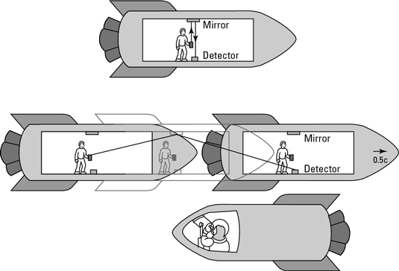
Example: Time Dilation
Einstein said, “The speed of light must be the same in any reference frame”. For example, the time it takes light to bounce off a mirror in a spaceship must be the same whether it’s measured by someone in the spaceship, or someone outside of the spaceship.
This seems weird, but it applies to everything we with, eg, accelerators
Example: the faster pions and muons move, the longer they live.
These two people have to measure the same speed for light, even though light is traveling a different distance for the two of them.
The only solution? More time passes for the stationary observer than the guy in the spaceship!
“Twin Paradox”

Slide 25
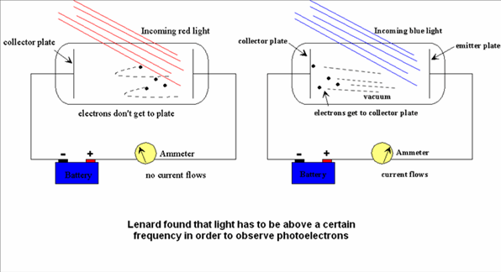
Now we’re done, right?
Well….
Around the turn of the last century, Philipp Lenard observed the “photoelectric effect”:
light could knock electrons out of material and create an electric current, but their energy depended only on the color, not the intensity.
This really had people scratching their heads!

Slide 26
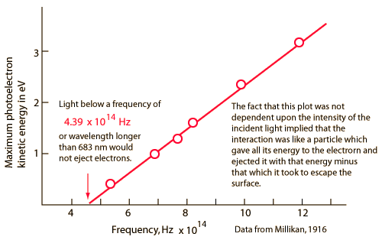
Einstein to the rescue (again)
The same year he proposed the Theory of Relativity, Einstein suggested a new theory for light
Really, at this point, he was just showing off
He hypothesized that light consisted of “packets”, each with an energy that depended on its wavelength:
Shorter wavelengths have higher energy, and can therefore kick out electrons with higher energy.
Planck’s Constant
Speed of light
Energy
Wavelength

Slide 27
Wait! What the what?
I thought we had that whole particle/wave thing worked out after the discovery of interference, right?
Now Einstein was saying light was a particle again.
How could light be both a particle and a wave?
This question obsessed the best minds in the world for decades (and still does, really)
Over time, a working theory emerged, known as “quantum mechanics”
…and it’s really kind of weird!

Slide 28
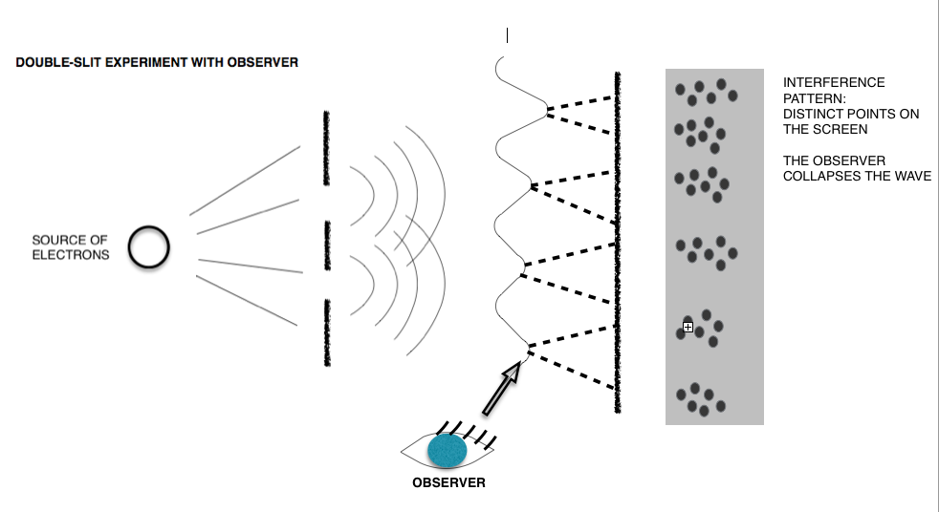
Quantum Mechanics
Light (and everything else) has a wavelength, which depends on its momentum
Particles propagate (and interfere!) as waves, but they are observed (interact) discretely, with a probability that depends on their amplitude.
At the smallest scales, everything is governed by random chance, and this introduces a fundamental uncertainty into our ability to measure things.
Momentum

Slide 29
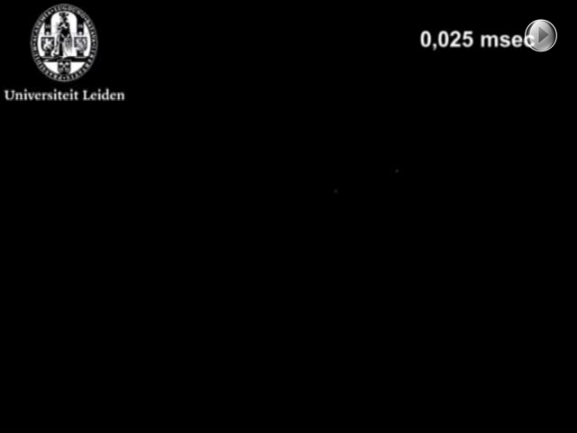
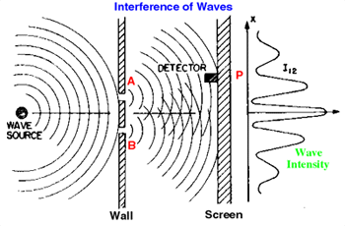
Example: Quantum Two-Slit Interference
Phosphor screen detects single photons from low intensity light source
When they add up, we see the interference pattern.

Slide 30
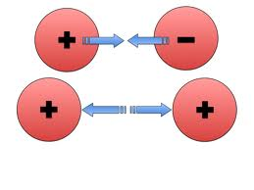
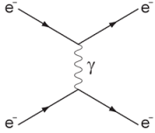
Quantum Electrodynamics (QED)
Based on the work of Richard Feynman and others, we now view the electric field as the discrete exchange of photons.
If the probability is high enough, you exchange a lot of photons and quantum ➔ classical again.
Classical picture: charged particles produce “fields”, which exert forces on other particles
Quantum picture: charged particles have a probability of exchanging “virtual photons”
“Feynman Diagram”

Slide 31
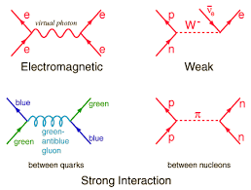
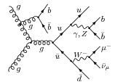
The Rest is History…
This formalism became the model for how we treat all forces
They’re literally the basis of everything we do in fundamental physics

Slide 32
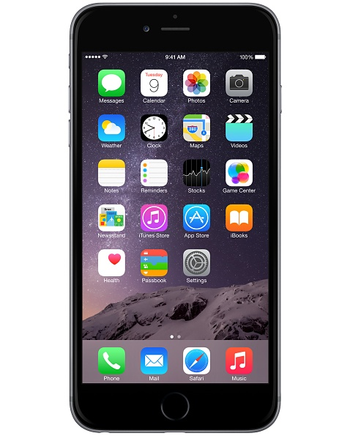
Summary: The “Light” in Your Smart Phone…
Processor/circuits
Fabrication
Classical optics (lithography)
Photoelectric effect
Operation
Quantum mechanics
Heat dissipation
Radiant heat theory
LCD Screen
Quantum mechanics
Camera
Lens
Classical optics
CCD
Photoelectric effect
Phone and wireless signals
Electrodynamics
GPS
Atomic clocks
quantum mechanics
Signals
electrodynamics
Corrections
Special and General relativity

Slide 33
Backup Slides

Slide 34
Backup slides

Slide 35
Outline
The basics (easy stuff)
Reflection
Refraction
Ray tracing and images
Interference
Big surprises (hard stuff)
Speed of light
Electricity and Magnetism
Theory of Relativity
Quantum Mechanics and Quantum Electrodynamics
What this teaches us about how science is done
How this relates to what we do here

Slide 36
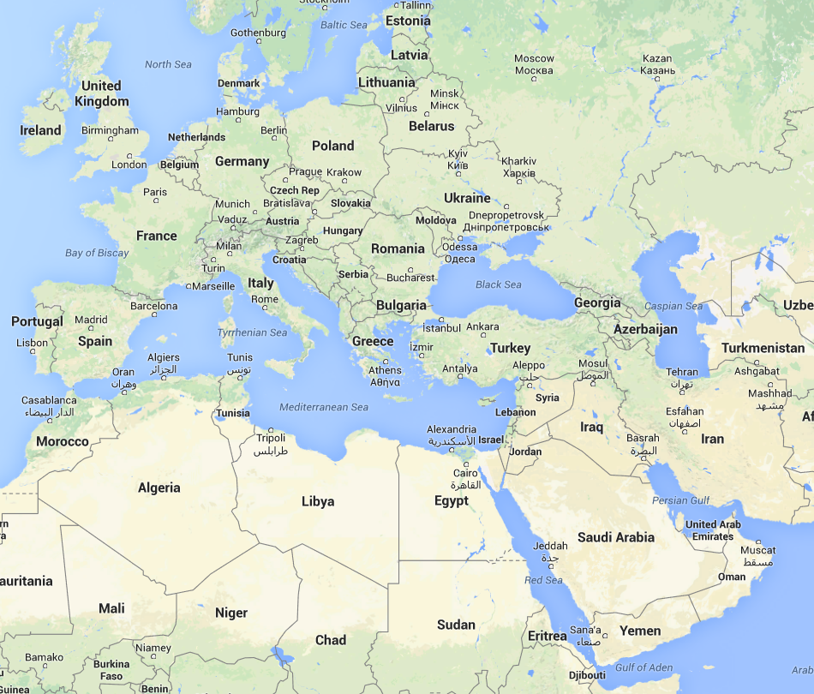
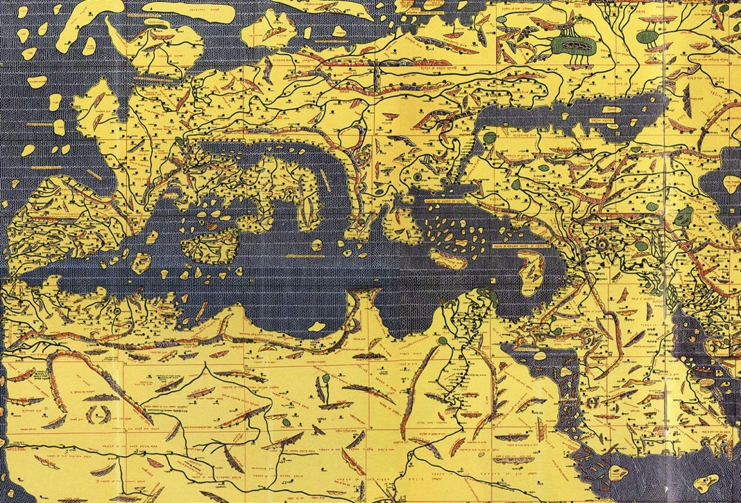
Maps
Latitude was determined by stars
Pretty Accurate
Longitude was determined by dead reckoning
Often way off
“Tabula Rogeriana” Muhammed al-Idrisi, 1154
(North was originally down)

Slide 37
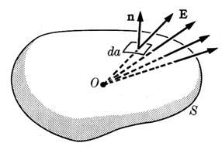
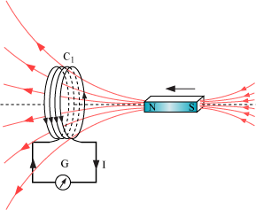
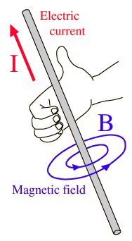
Maxwell’s Equation’s
In 1861, James Clerk Maxell attempted to collect everything that was known about Electricity and Magnetism into a single set of equations.
Coulomb’s Law:
The electric field passing through a surface depends on the charge contained by that surface
Faraday’s Law:
The electric field around a closed path depends on the rate of change of a magnetic field passing through the path.
Ampere’s Law:
The magnetic field around a closed path depends on the electric current (flowing charge) passing through the path

Slide 38
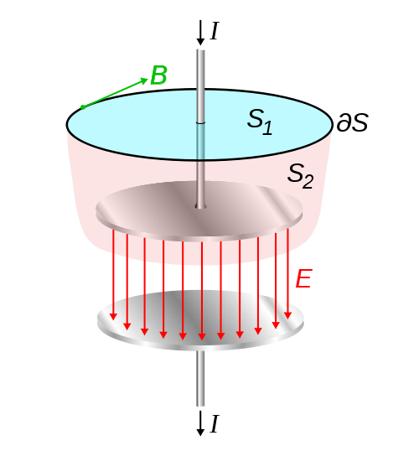
Displacement Current
There was a problem with Ampere’s Law
Because electrical current can be blocked, there is no unique definition of the current passing through a loop.
Maxwell had a “fix”
Any interruption in electric current causes a changing electric field.
For purely mathematical reasons, Maxell hypothesized that a magnetic field could be created by an electric current or a changing electric field.
This didn’t affect a single measurement that had been made until that point, but it had profound implications.
Current flowing here
Field changing here

Slide 39
Implications of Quantum Mechanics
At the smallest scales, things occur randomly. We can talk about probabilities, but not certainties.
The act of “observing” is never passive.
Example: we see because a photon hits the retina of our eye, causing a quantum transition.
The fact that observation requires interaction introduces a fundamental uncertainty into our ability to measure things.

Slide 40
The Quest for Longitude
By the 17th century, longitude was THE big problem for navigation.
Numerous governments offered large prizes to the first person who could reliably determine longitude (ie, measure absolute time) over large distances.
Many believed that such accuracy could never be achieved with a mechanical clock, and would have to rely on some celestial reference.
This drove a period of intense advancement in observational astronomy
spoiler alert: John Harrison eventually solved the problem with a clock*
*see “Longitude” by Dava Sobel

Slide 41
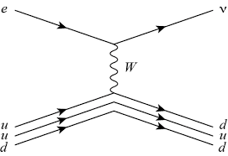
The Rest is History…
QED became the basis for our models of the other forces.
In quantum mechanics, a “force” is something that changes the “state” of a particle, which can sometimes mean changing it into another particle.
And that’s just the beginning…
QED
Weak Interaction
Neutrino
“W” (like a photon but about 100 times as heavy as the proton!)
Proton

Slide 42
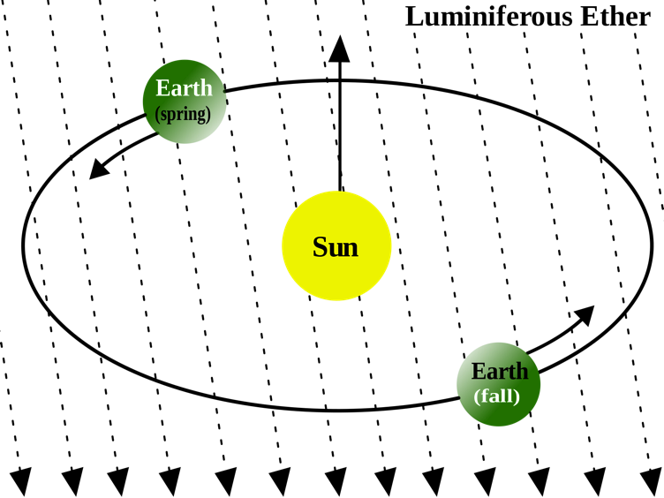
Michelson-Morley Experiment
If aether exists, then it must fill space and the earth must be passing through it.
Light traveling along the direction of the Earth’s motion should have a slightly different wavelength than light traveling transverse to it.
In 1887, Albert Michelson and Edward Morley performed a sensitive experiment to measure this difference.
Their result:
No difference ➔ no aether!
Biggest mystery in science for almost 20 years.

